Slide 1

Charcot-Marie-Tooth disease
Introduction
Charcot-Marie-Tooth (CMT) affects the peripheral nerves.
These are the nerves outside the main central nervous system (CNS). They control the muscles and relay data from the arms and legs to the brain, allowing a person to sense touch.
Symptoms of Charcot-Marie-Tooth disease typically appear in adolescence or early adulthood, but may also develop in midlife

Slide 2
Charcot-Marie-Tooth disease
Clinical manifestation /Symptoms
Weakness in your legs, ankles and feet
Loss of muscle bulk in your legs and feet
High foot arches
Curled toes (hammertoes)
Decreased ability to run
Difficulty lifting your foot at the ankle (footdrop)
Awkward or higher than normal step (gait)
Frequent tripping or falling
Decreased sensation or a loss of feeling in your legs and feet

Slide 3
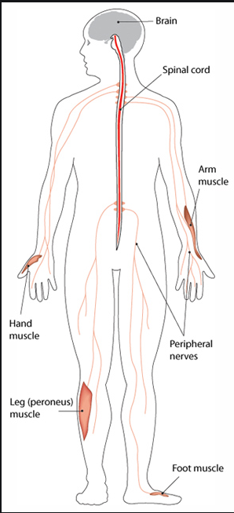
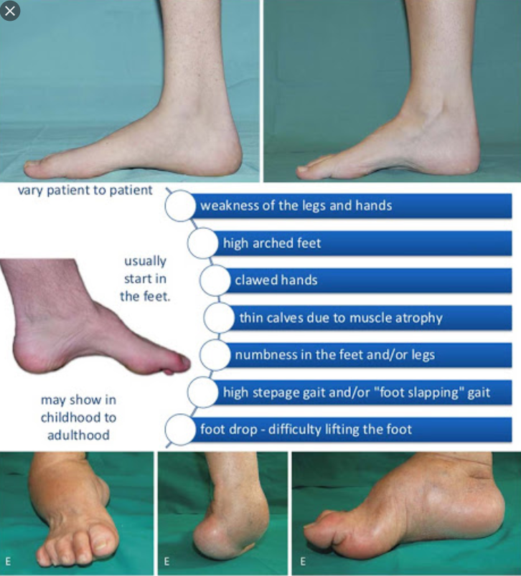
Charcot-Marie-Tooth disease
Clinical manifestation /Symptoms

Slide 4
Charcot-Marie-Tooth disease
Causes
Charcot-Marie-Tooth disease can be caused by mutations in many different genes.
These genes provide instructions for making proteins that are involved in the function of peripheral nerves in the feet, legs, and hands.
The gene mutations that cause Charcot-Marie-Tooth disease affect the function of the proteins in ways that are not fully understood; however, they likely impair axons, which transmit nerve impulses, or affect the specialized cells that produce myelin.
various types of Charcot-Marie-Tooth disease, subtypes (such as CMT1A, CMT1B, CMT2A, CMT4A, and CMTX1) indicate different genetic causes.

Slide 5
Charcot-Marie-Tooth disease
Inheritance Pattern
CMT1, most cases of CMT2, and most intermediate forms are inherited in an autosomal dominant pattern.
CMT4, a few CMT2 subtypes, and some intermediate forms are inherited in an autosomal recessive pattern.
CMTX is inherited in an X-linked dominant pattern.

Slide 6
Charcot-Marie-Tooth disease
Gene Panel
AARS, AIFM1, ATL1, ATP7A, BSCL2, COX6A1, DHTKD1, DNAJB2, DNM2, DNMT1, DYNC1H1, EGR2, ELP1, FGD4, FIG4, GAN, GARS, GDAP1, GJB1, GNB4, HINT1, HSPB1, HSPB8, IGHMBP2, INF2, KIF1A, KIF1B, KIF5A, LITAF, LMNA, LRSAM1, MARS, MED25, MFN2, MPZ, MTMR2, NDRG1, NEFL, NGF, NTRK1, PDK3, PLEKHG5, PMP22, PRPS1, PRX, RAB7A, REEP1, RETREG1, SBF1, SBF2, SH3TC2, SLC12A6, SPTLC1, SPTLC2, TRIM2, TRPV4, TTR, WNK1, YARS
No of Genes : 59
Sample Type : EDTA-blood sample - 4 ml
TAT : 6 Weeks
Methodology : NGS

Slide 7
Diagnostic Tests

Slide 9
Management

Slide 10
Duchenne muscular dystrophy
Reference
https://rarediseases.info.nih.gov/diseases/6291/duchenne-muscular-dystrophy
https://ghr.nlm.nih.gov/gene/DMD
https://www.healthline.com/health/duchenne-muscular-dystrophy#treatment

